Slide 1
RUNGTA COLLEGE OF DENTAL SCIENCES & RESEARCH
TITLE OF THE TOPIC: MICROBIOLOGY IN ENDODONTICS
DEPARTMENT OF CONSERVATIVE DENTISTRY AND ENDODONTICS

Slide 2
Specific learning Objectives
At the end of this presentation the learner is expected to know
Core areas* H | Domain ** | Category #
Routes of microorganism, Microrganism associated with root canal infection | Cognitive | Must know
Intraradicular infection, extraradicular infection | Psychomotor | Nice to know
Methods of identification of microbes | Affective | Desire to know
*Subtopic of importance
** Cognitive, Psychomotor or Affective
# Must know , Nice to know & Desire to know

Slide 3
TABLE OF CONTENT:
INTRODUCTION
ROUTES OF MICROORGANISM INGRESS
MICROORGANISMS FOUND IN ROOT CANALS ASSOCIATED WITH ENDODONTIC INFECTIONS
INTRARADICULAR INFECTION
EXTRARADICULAR INFECTION
METHODS FOR IDENTIFICATION OF MICROBES

Slide 4
INTRODUCTION
Even with new advances in instruments and techniques, controversy continues concerning the efficiency of canal preparation procedures employed in endodontics.
One of the basics of endodontic therapy – thorough removal of diseased or necrotic tissue from the root canal.

Slide 5
This includes, an attempt to eliminate microbes, their end products, and substrate needed for growth and to provide an environment that prevents reinfection
Without microbial involvement in the pulp and associated periapical tissues, there would be no need for endodontic therapy

Slide 6
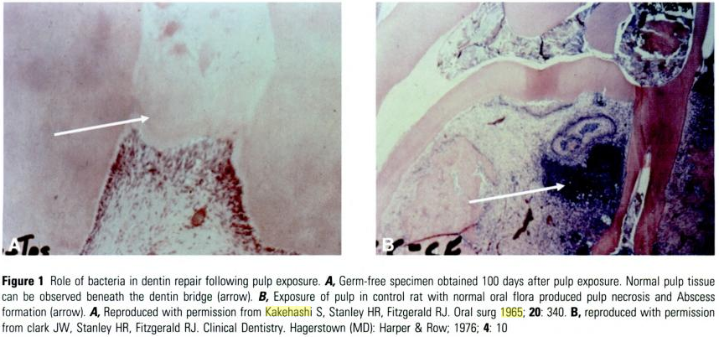
Kakehashi et al (1965) proved that without bacterial involvement, only minor inflammation occurred in exposed pulps.
Pulpal abscesses, periapical lesions, swelling and pain are the results of mixed microbial infections.

Slide 7
Discovery of the anarobic gram negetive rods, specifically black pigmented bacteria, and their relationship with other microbes in mixed infections, points to the close relationship between basic sciences and clinical practice in the special field of endodontics.
Sophisticated modern microbiologic studies have attempted to link specific bacteria with such symptoms as swelling, pain, and the production of purulence

Slide 8
A thorough understanding of these organisms, including their destructive potential, their requirements for growths, their routes of entry, their sensitivity to pharmaco-therapeutic agents, their synergistic dependence on each other, and their relationship to clinical symptoms is necessary to formulate a sound approach to root canal therapy

Slide 9
ROUTES OF MICROORGANISM INGRESS
THROUGH OPEN CAVITY
THROUGH DENTINAL TUBULES
THROUGH THE GINGIVAL SULCUS/ PDL
THROUGH BLOOD STREAM
THROUGH BROKEN OCCL. SEAL/ FAULTY RESTORATION
THROUGH EXTENSION OF A PERIAPICAL INFECTION FROM ADJACENT INFECTED TOOTH

Slide 10
M.orgs can reach the dental pulp by any of six routes.
During dental procedures these possible paths must be considered to prevent ingress
Because the pulpal stump and periapical tissues are usually inflamed to some degree during endodontic procedure, these areas would be affected adversely if m.org were allowed access
Maintenance of occlusal and peripheral seal

Slide 11
1. Through open cavity
Most obvious route, as a result of dental caries.
Enamel and dentin provide excellent layer of protection.
Once damaged, protection is reduced
As irritant approach the pulp, new protective layer of reparative dentin may be laid down

Slide 12
The rapidity and degree of this additional dentin deposition varies with individual, but rarely can prevent microorganism entry without intervention by some type of caries excavation.
Traumatic injuries and dental procedures also may remove protective layer and allow access to pulp.

Slide 13
2. Through the dentinal tubules
Researches has shown that m.orgs will penetrate into dentinal tubules and be able to reach the pulp.
Because bacteria are smaller (< 4µ in diameter) than the diameter of dentinal tubules, may enter tubules from salivary contamination during operative procedures or through adjacent carious lesions

Slide 14
M.orgs able to penetrate after cavity preparation are usually low in number and virulence and rarely causes clinical symptoms of pulpitis
The presence of impression materials, temporary restorative materials, acids and cements may drive m.orgs from surface into the pulp
Phagocytic action by the defence cells of the pulp can frequently remove these invaders and retain a healthful environment.

Slide 15
Even though irritation of this, may not cause clinical symptoms, protection for the pulp is available
Tubules sealents such as varnishes, sedative bases or sedative cements should be used over exposed dentin in proximities to the pulp
However when a deep carious lesion brings high numbers of m.orgs to tubules in proximity to the pulp, it has been shown that bacteria will penetrate to the pulp well in advance of the carious process

Slide 16
3.Through gingival sulcus/PDL
M.orgs and other irritants from the periodontal ligament may reach the pulp through the vessels in the apical foramen or any auxiliary foramina present.
Also, in some teeth, auxiliary canals may be present at some distance from the apex of root, toward the crown of the tooth.

Slide 17
If periodontal disease destroys the protecting bone and soft tissues to a sufficient degree, the canal may be exposed to microorganism present in the gingival sulcus
Pulp exposure occurs without any caries or trauma, but with heavy ingress of irritants

Slide 18
4. Through the blood stream
A transient bacteremia may occur for any number of reasons during the normal day of healthy individual.
Studies have been undertaken to determine whether bacteria present in the blood would be attracted to the dental pulp following trauma or operative procedure that produced inflammation without causing pulp exposure

Slide 19
This attraction is known as anachoresis and has been described in classic studies of inflammation.
Hypotheses concerning this anachoretic effect were given to explain the finding of a periapical lesion with bacterial contamination in connection with a tooth in which the pulp became necrotic due to trauma
To clarify this, research by Smith and Tappe demonstrated that trauma to teeth could attract bacteria in the absence of pulp exposure

Slide 20
5. Through broken occl.seal/ faulty restoration
Controlled studies by torabinejad et al. have proven that salivary contamination from the occlusal aspect can reach the periapical area in less than 6 weeks in canals obturated with gutta percha and sealer
If there is delay in restorative procedures following endodontic therapy and the temporary seal is broken, if the tooth structure fractures before final restoration, or if the final restoration is inadequate , bacteria may gain access to the periapical tissue and result in infection

Slide 21
This problem is often compounded by hydrophillic composite cores placed under cast restorations that begin to leak with time, absorb contaminants and serve as reservoir of bacteria.
Unused post space further complicates the situation in a leaking restorative system acting as an incubator for anarobic bacteria, inviting them to travel to the periradicular tissue through apex

Slide 22
6. Through extension of a periapical infection from adjucent tooth
There is a considerable question whether or not bacteria from a periapical area will enter an adjacent, or noninfected tooth.
Large periapical radiolucencies may appear to encompass the roots of multiple teeth, yet be caused by pulp necrosis of only one tooth.

Slide 23
This occurs with greatest frequency in the mandibular anterior teeth.
Only the causative tooth is treated endodontically, and the entire radiolucency heals.
Of course, if a pulpitis or trauma severely affects a tooth and its neighbor does have an infected periapical area, the m.org may reach the newer problem by the interlacing blood and lymph systems, by physical extension, or by pressure.

Slide 24
Once the dental pulp become necrotic, the root canal system becomes a privileged sanctuary for clusters of bacteria, bacterial by-products, and degradation products of both the m.orgs and pulpal tissue

Slide 25
Teaching Materials
Endodontic practices - Grossman
Pathways of pulp – Cohen
Textbook of Endodontics – Nisha Garg
Endodontics - Ingle

Slide 26
TAKE HOME MESSEGE/ FOR THE TOPIC COVERED (SUMMARY)
Infection of the root canal is not a random event.
The type and mix of the microbial flora develop in response to the surrounding environment. Microorganisms that establish in the untreated root canal experience an environment of nutritional diversity.
In contrast, well-filled root canal offers the microbial flora a small, dry, nutritionally limited space.
Thus, we should obtain a better understanding of the characteristics and properties of bacteria and their biofilms along with the environmental changes, to enhance success.

Slide 27
Question & Answer Session
Describe routes of microorganism ingress

Slide 28
REFERENCES
Endodontic practices - Grossman
Pathways of pulp – Cohen
Textbook of Endodontics – Nisha Garg
Endodontics - Ingle

Slide 29
THANK YOU

